Slide 1

Customer Shopping Behavior Analysis
Analysis of 3,900 transactions to reveal spending patterns, segments, product preferences, and subscription behavior to guide strategy.

Slide 2

Dataset Summary
Scope
Key Features
Missing Data
3,900 rows · 18 columns including demographics, purchase details, and behavior metrics.
Age, Gender, Location, Item, Category, Purchase Amount, Season, Rating, Subscription, Shipping, Discounts.
37 missing values in Review Rating column handled during cleaning.

Slide 3

Data Preparation & Feature Engineering
Loaded with pandas; inspected with df.info() and .describe(). Imputed Review Rating nulls using category median, standardized column names to snake_case.
Engineered age_group bins and purchase_frequency_days. Dropped redundant promo_code_used and loaded cleaned DataFrame into PostgreSQL.

Slide 4

Exploratory Statistics
Summary Metrics
Average purchase: $59.76 · Average review rating: 3.75 · Total customers: 3.9K
Distribution
Age mean 44.07 (sd 15.21). Purchase amount range $20–$100; 25th=39, median=60, 75th=81.

Slide 5
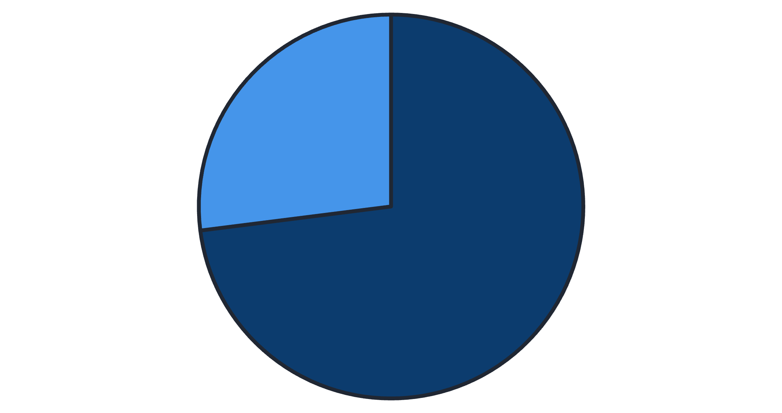
Revenue & Subscription Insights
Subscribers: 1,053 (27%). Non-subscribers: 2,847 (73%). Avg spend — Subscribers: $59.49 (total $62,645). Non-subscribers: $59.87 (total $170,436).
No
Yes

Slide 6
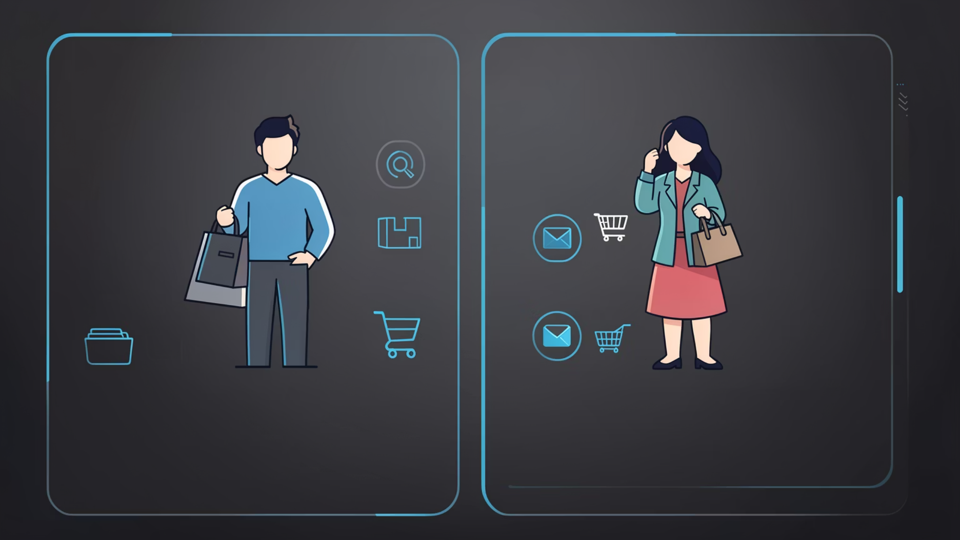
Revenue by Gender & Shipping
Revenue by Gender
Female: $75,191 · Male: $157,890
Shipping Comparison
Average purchase — Standard: $58.46 · Express: $60.48

Slide 7


Top Products & Discount Dependence
Top Rated Items
Discount-Dependent
Gloves (3.86), Sandals (3.84), Boots (3.82), Hat (3.80), Skirt (3.78)
Highest discount rates: Hat 50.00%, Sneakers 49.66%, Coat 49.07%, Sweater 48.17%, Pants 47.37%

Slide 8

Customer Segments & Loyalty
Returning — 701
Segmentation based on purchase history: Loyal 3,116; Returning 701; New 83. Repeat buyers (>5 purchases) are more likely to be non-subscribers in the dataset: repeat buyers — No: 2,518 / Yes: 958.
Loyal — 3,116
New — 83

Slide 9

Revenue & Sales by Category and Age Group
By Category
Revenue: Clothing ~$100K, Accessories ~$70K, Footwear ~$30K, Outerwear ~$20K. Sales: Clothing ~1,800; Accessories ~1,200; Footwear ~500; Outerwear ~200.
By Age Group
Revenue: Young Adult $62,143 · Middle-aged $59,197 · Adult $55,978 · Senior $55,763. Sales roughly mirror revenue distribution.

Slide 10

Business Recommendations
Boost Subscriptions
Loyalty Programs
Review Discount Policy
Promote exclusive benefits to increase subscriber share and recurring revenue.
Incentivize repeat buyers to move more customers into the Loyal segment.
Balance short-term sales lifts with long-term margin preservation for discount-dependent items.
Product & Marketing Focus
Highlight top-rated and best-selling products; target high-revenue age groups and express-shipping users.

